Slide 1
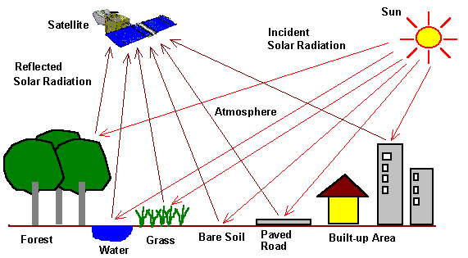
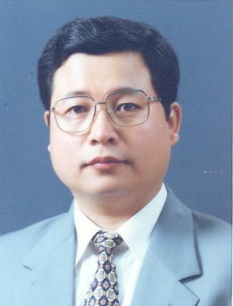
2019, The first INU-ENU joint form on TC305 geotechnical infrastructure for Mega cities and new capitals
Astana, Kazakhstan, 25th February 2019
VEGETATION ANALYSIS IN THE WESTERN PART OF SOUTH KOREA USING OPEN SOURCE QGIS TOOLKIT
Ph.D., Yong Chang LEE
Professor, Department Head of Urban Construction Engineering, Incheon National University, Republic of Korea
E-mail : yclee@inu.ac.kr, Homepage : http://scity.inu.ac.kr

Slide 2
Presentation contents
Introduction
Study site and Materials 2.1 Study site 2.2 Sentinel 2A/2B imagery 2.3 SNAP and QGIS with SCP plugin
Methodology
Results and Discussion 4.1 Specific bands combinations based classification comparison 4.2 Vegetation indices based classification comparison
Conclusions and Recommendation

Slide 3
Project motive
Remote sensing application using satellite and drones imagery have been used effectively in various industries.
The Korean government has been struggling for effective agricultural and forest policy. In particular, Seeking various policies to minimize the damage of domestic farmers due to imports of agricultural products under FDA agreement with foreign countries.
As an example, there is a system that provides compensation to farmers who stop farming. Therefore, the State should investigate agricultural land, forest area, etc. every year, Farmers are also adopting smart farming technology for efficient science farming.

Slide 4
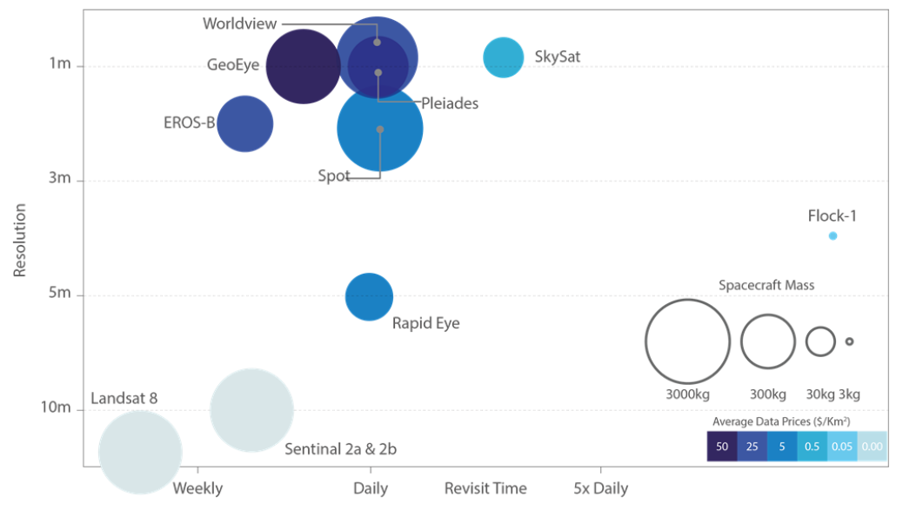
Figure : Spatial Resolution vs Revisit Time for various example satellites
(Source: Satellite Applications Catapult 2017, adapted from EO21 Project)
An overview of some of the more commonly used EO satellites
in terms of spatial resolution and revisit time

Slide 5
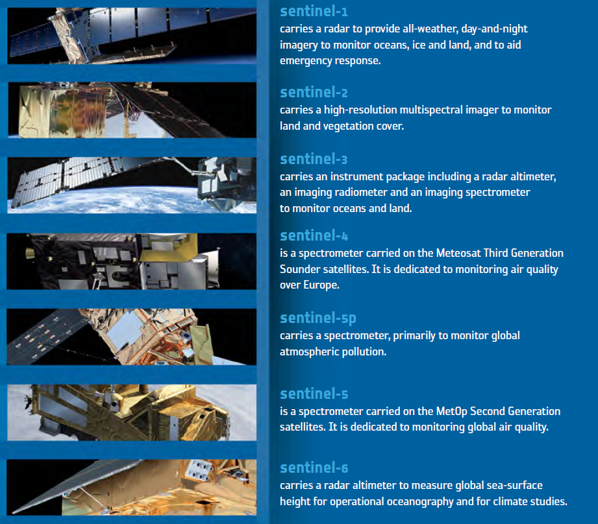
Copernicus program mission operations
Sentinels for Copernicus
ESA is developing a new family of missions called Sentinels specifically for the operational needs of the Copernicus program. Each Sentinel mission is based on a constellation of two satellites to fulfil revisit and coverage requirements, providing robust datasets for Copernicus Services. These missions carry a range of technologies, such as radar and multi-spectral imaging instruments for land, ocean and atmospheric monitoring
Sentinel-2 is a polar-orbiting, multispectral high-resolution imaging mission for land monitoring to provide, for example, imagery of vegetation, soil and water cover, inland waterways and coastal areas. Sentinel-2 can also deliver information for emergency services. Sentinel-2A was launched on 23 June 2015 and Sentinel-2B followed on 7 March 2017.

Slide 6
Sentinel-2 mission is based on a constellation of two identical satellites in the same orbit, 180° apart for optimal coverage and data delivery. The Sentinel 2 satellites have a Multi-Spectral Instrument (MSI) with 13 spectral bands that range from the visible range to the shortwave infrared (SWIR). Bands come in variable resolutions from 10 to 60 meter and their wavelength is determined based on specific purposes. False color images are used to enhance certain cover types as vegetation on the image representation.
The mission supports operational applications primarily for land services, including the monitoring of vegetation, soil and water cover, as well as the observation of inland waterways and coastal areas. Sentinel-2 will complement mission such as SPOT or Landsat.
Sentinel-2 Bands | Central Wave length [micrometers] | Resolution [meters]
Band 1 - Coastal aerosol | 0.443 | 60
Band 2 - Blue | 0.490 | 10
Band 3 - Green | 0.560 | 10
Band 4 - Red | 0.665 | 10
Band 5 - Vegetation Red Edge | 0.705 | 20
Band 6 - Vegetation Red Edge | 0.740 | 20
Band 7 - Vegetation Red Edge | 0.783 | 20
Band 8 - NIR | 0.842 | 10
Band 8A - Vegetation Red Edge | 0.865 | 20
Band 9 - Water vapour | 0.945 | 60
Band 10 - SWIR - Cirrus | 1.375 | 60
Band 11 - SWIR | 1.610 | 20
Band 12 - SWIR | 2.190 | 20

Slide 7
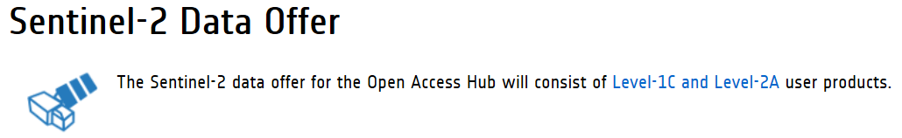
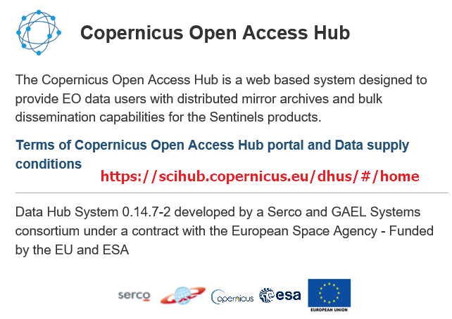





https://scihub.copernicus.eu/userguide/
https://sentinels.copernicus.eu/web/sentinel/sentinel-data-access/typologies-and-services

Slide 8
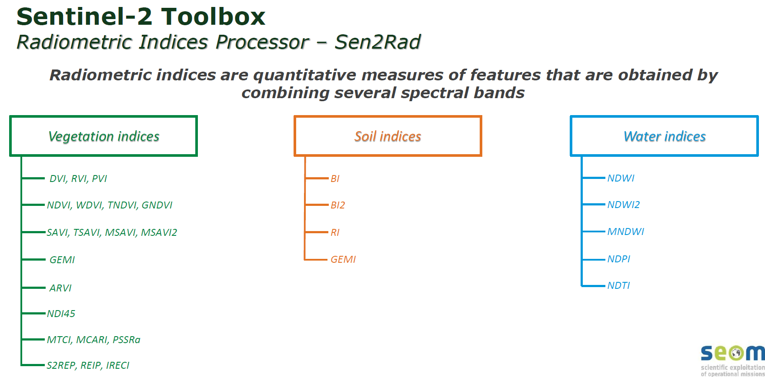
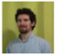
SNAP Sentinel Application Platform
A common architecture for all Sentinel Toolboxes is being jointly developed by Brockmann Consult, Array Systems Computing and C-S called the SNAP which is ideal for Earth Observation processing and analysis.
FOSS4G
Free and Open Source Software for Geospatial
• Third Party Plugin : SEN2COR
https://www.osgeo.org/initiatives/foss4g/
QGIS, SCP plugin
Developed by Luca Congedo , the Semi-Automatic Classification Plugin (SCP) is a free open source plugin for QGIS that allows for the semi-automatic classification (also supervised classification) of remote sensing images. It provides several tools for the download of free images, the preprocessing, the postprocessing, and the raster calculation.
SCP Manual : https://fromgistors.blogspot.com/p/user-manual.html?spref=scp
Luca Congedo

Slide 9
The objective of this project
was to investigate the application to the national agricultural policy and the utilization of smart scientific farming for farmer from consideration of the time series distribution of the vegetation index at the field test for the western part of South Korea with the open source toolkits.
For these objects, we analyzed Sentinel-2 satellite imagery to investigate the distribution of green space ratio of crop field and forest by both calculation of several vegetation indices and combination of various RGB bands.
A special feature of this project
is that both satellite imagery and image analysis tools utilize open source. The spatial resolution of Sentinel 2 satellite image is 10m, which is free to use as Landsat satellite image and has better resolution than Landsat image with 30m spatial resolution. Especially, in case of commercial supply, the average price of satellite imagery is $50 per square km.

Slide 10
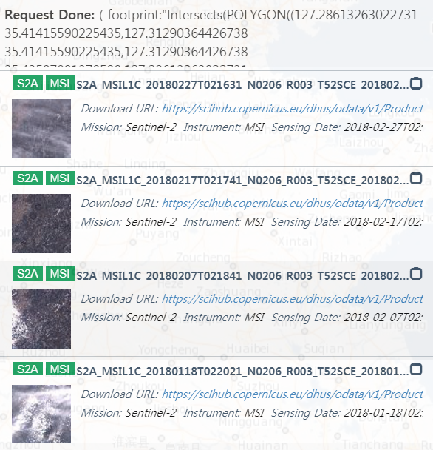
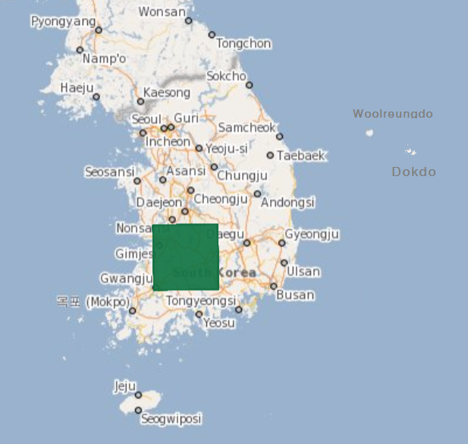
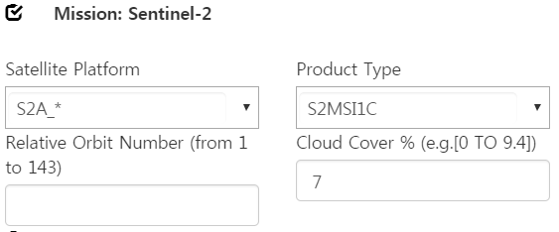
Study Site and Materials
Cloud Cover
Percentage
6.7
6.6
10.8
83.2

Slide 11
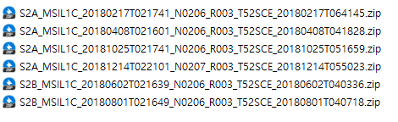
Sentinel 2A/2B image used in this study
Cloud Cover
Percentage
6.640%
0.216%
1.970%
0.221%
0.163%
1.138%
YearMMDD
hhmmss
UTC
Scanning time
Korean Time : UTC + 9h, AM 11:16 – 11:21

Slide 12
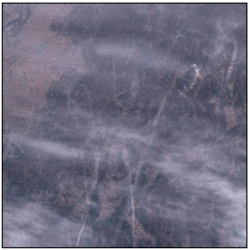
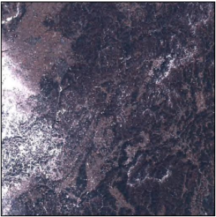
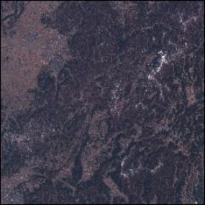
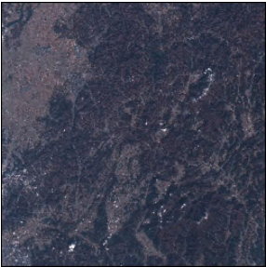
The cloud
content
of
each
images
96.7
10.8
S2A_MSIL1C_20180227T021631
S2A_MSIL1C_20180207T02184
6.6
2.5
S2A_MSIL1C_20180217T02174
S2B_MSIL1C_20181229T022109

Slide 13
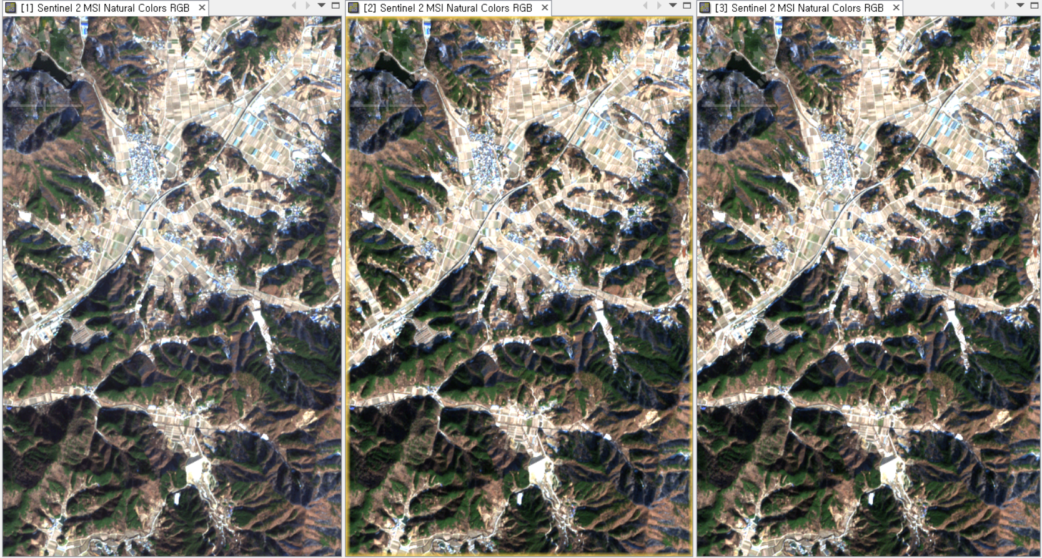
TOA input image L1C Atmospheric corrected BOA BOA L2A image from Hub
simulated L2A from L1C image (Results from ESA)
Figure TOA Level-1C image(left), associated Level-2A BOA image(center) generated using Sen2cor
toolbox, and Level-2A BOA image(right) download from data Hub
(3rd January, 2019, Natural color, Cloud cover percentage 1.23%)

Slide 14

Methodology
Natural vegetation cover and agricultural crops are frequently the subjects of remote sensing studies. The information obtained in this way is a source of knowledge used for monitoring and evaluating the Earth’s vegetative cover.
Using by QGIS-SCP plugin and SNAP toolbox explores classification using
The selected bands combination(SBc : specific bands combinations based classification)
Table 3 summarizes the individual characteristics of each of the 12 types of band combinations. In this paper, six types of band combinations were selected and used for vegetation analysis.
Explores classification based on vegetation indices
(VIs : vegetation indices based classification).

Slide 15
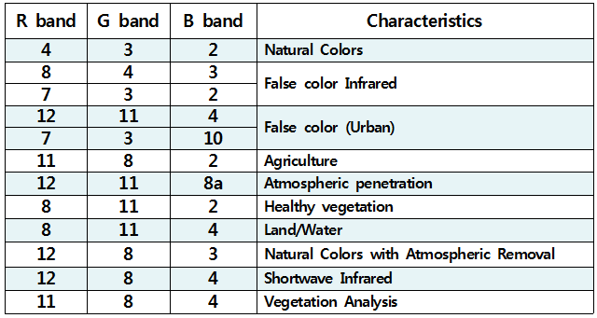
Twelve types of band combinations and it’s characteristics

Slide 16
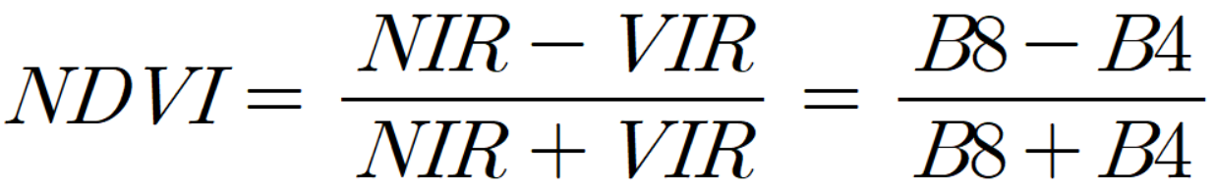
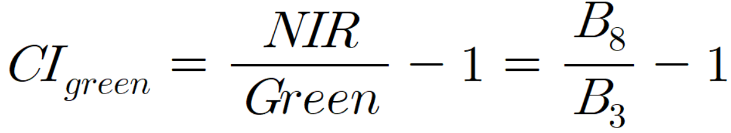
Normalized Difference Vegetation Index : NDVI
Equation for SENTINEL-2 NDVI
- > Water, 0<= Soil < 0.1, Vegetation > 0.1
Green Chlorophyll Index for Senescing Vegetation
Equation for SENTINEL-2 CIgreen
This index eliminates highly reflective senescing vegetation using filtering tests on
band 8/band 3 reflectance ratio. Senescing vegetation is highly reflective in NIR and more highly reflective in the green than green vegetation. The band 8/band 3 reflectance ratio is higher for vegetation than for cloud or other scene features.
https://sentinel.esa.int/web/sentinel/technical-guides/sentinel-2-msi/level-2a/algorithm

Slide 17
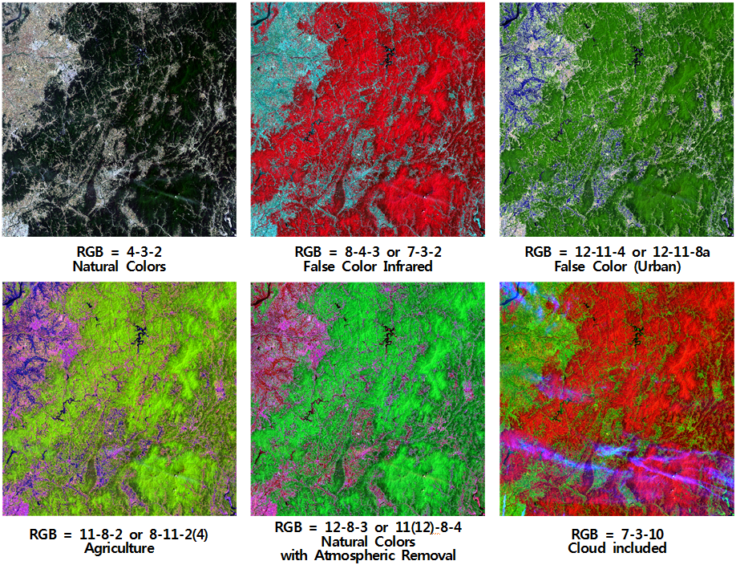
Results and Discussion
Specific Bands Combinations based Classification Comparison
Figure 2.
Six kinds of Sentinel-2 images bands combination map calculated in QGIS-SCP plugin
(Cloud percentage = 1.97%, results for 2nd June 2018)

Slide 18
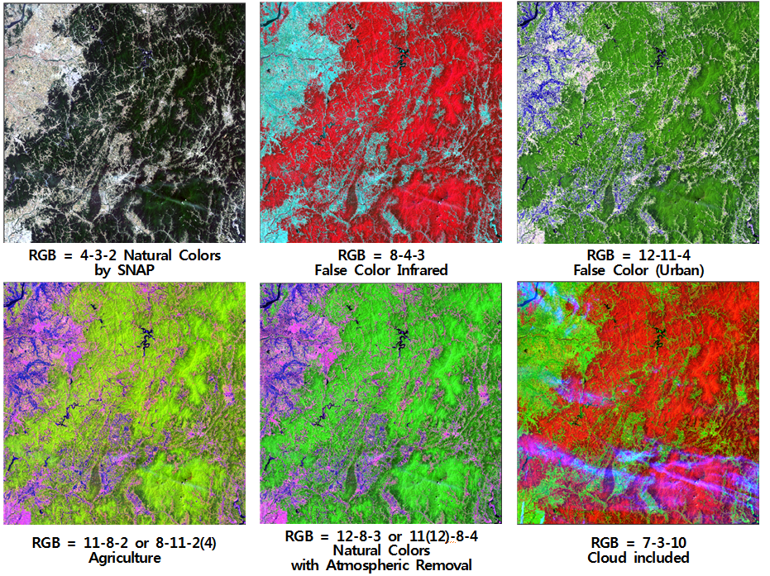
Specific Bands Combinations based Classification Comparison
Figure 3.
Six kinds of Sentinel-2 images bands combination maps
calculated in SNAP scientific toolbox.
(Cloud percentage = 1.97%,
Results for 2nd June 2018)

Slide 19
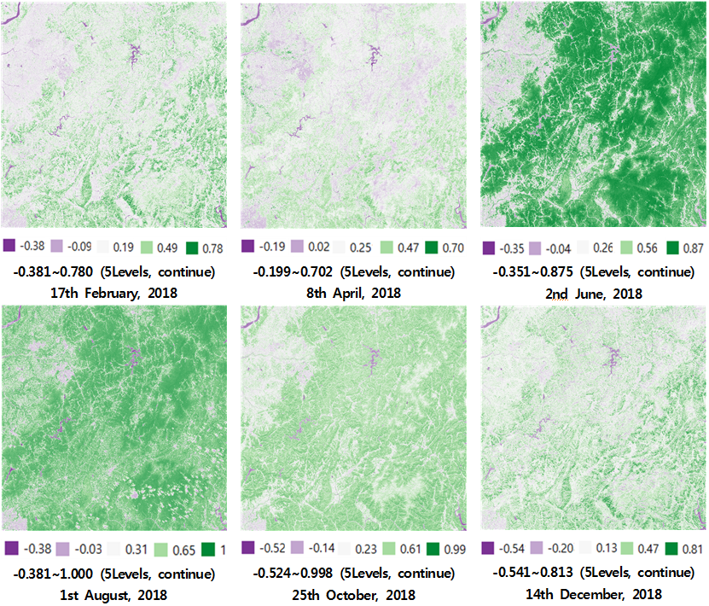
Vegetation Indices based Classification Comparison
Figure 4.
Four-season time-series NDVI map distribution calculated by QGIS-SCP plugin in 2018 year
The distribution of the NDVI index in June ranges from -0.351 to 0.875, while the vegetation index in August ranges from -0.381 to 1.000, indicating improved vegetation vitality.

Slide 20
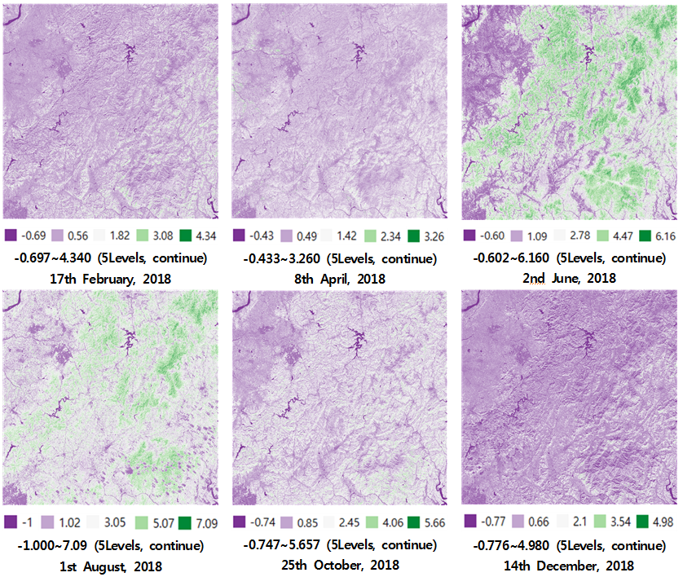
Vegetation Indices based Classification Comparison
Figure 5.
Four-season time-series CIgreen index map distribution calculated by QGIS-SCP plugin in 2018 year
The following figure 5 shows CIgreen vegetation index map by QGIS-SCP analysis.
Although the seasonal classification status is less than the NDVI vegetation index described above, but the overall trend is similar to the NDVI vegetation distribution.

Slide 21
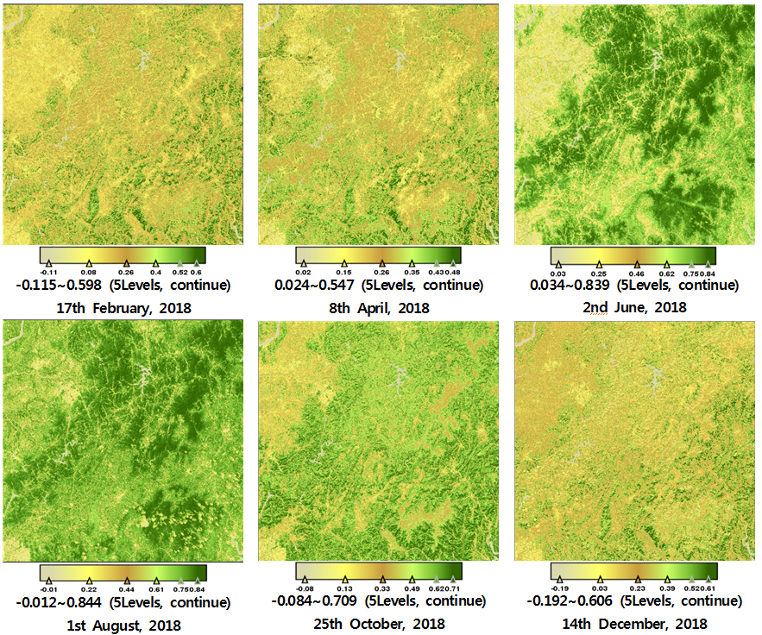
Vegetation Indices based Classification Comparison
Figure 6.
Four-season time-series Sentinel-2 images NDVI map calculated by SNAP in 2018 year
The distribution of the NDVI index in June ranges from 0.034 to 0.839, while the vegetation index in August ranges from -0.012 to 0.844, indicating improved vegetation vitality.

Slide 22
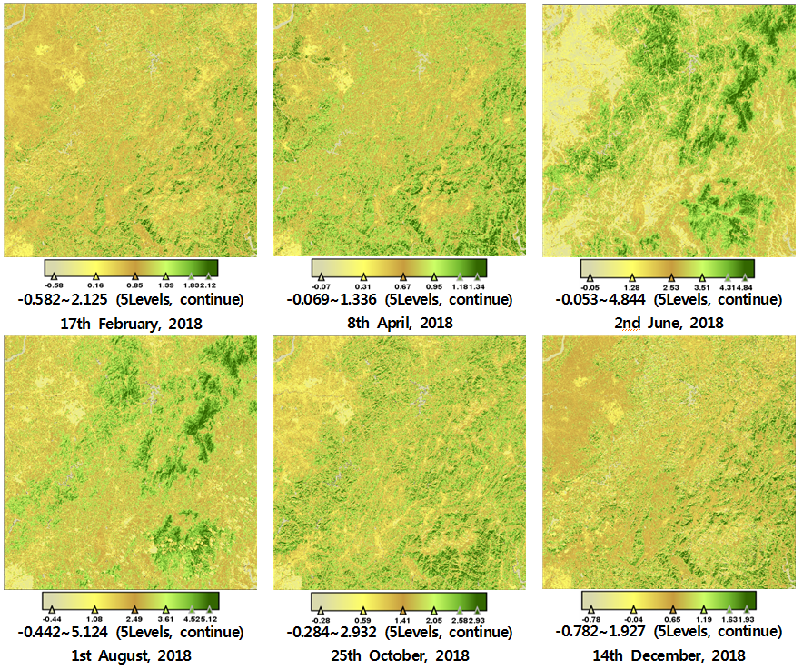
Figure 7.
Four-season time-series Sentinel-2 images CIgreen index map calculated by SNAP in 2018 year
Figure 7 shows CIgreen vegetation index map by SNAP toolbox analysis. Although there are some factors depending on the type of color template and the number of grade intervals, but the overall trend is similar to the NDVI vegetation distribution by SNAP.

Slide 23
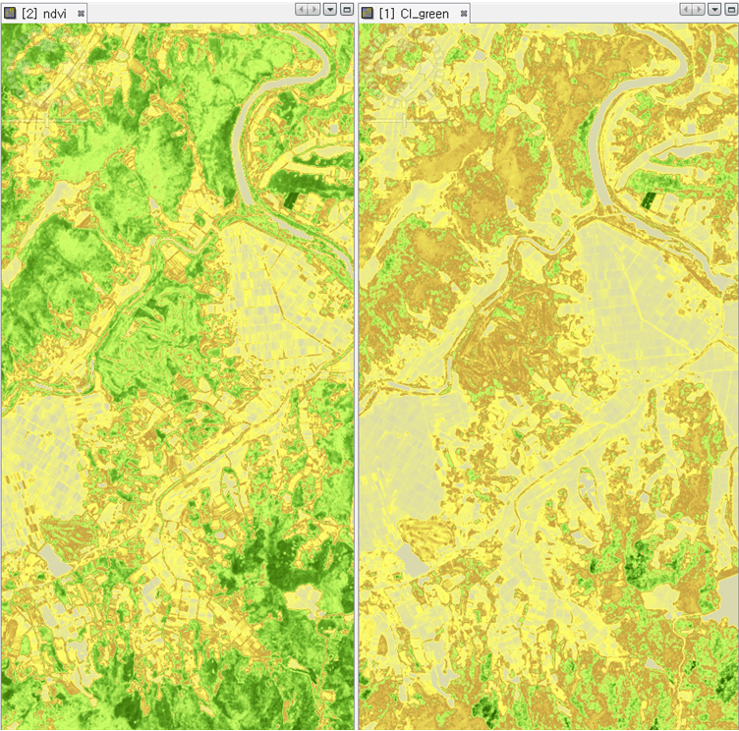
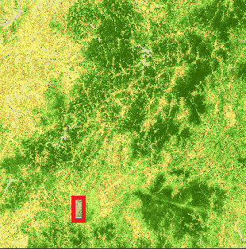
NDVI
CIgreen
Enlarged map of
NDVI (left) and CIgreen(right)
vegetation indices distribution
by SNAP toolbox
at the red square area
of study site
on June 2, 2018

Slide 24
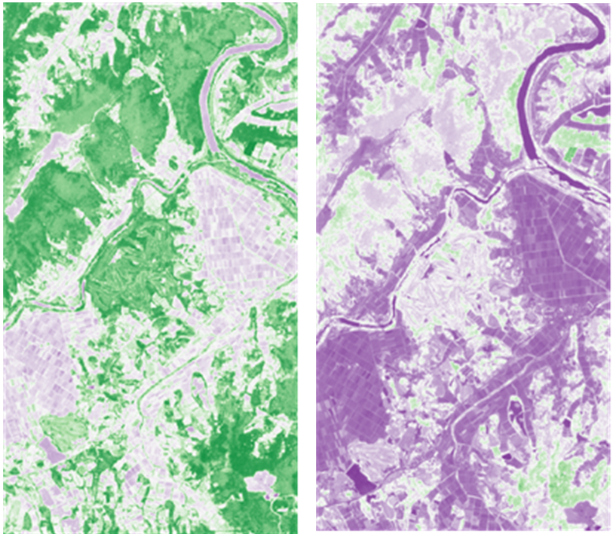
NDVI
CIgreen
Enlarged map of
NDVI (left) and CIgreen(right)
vegetation indices distribution
by QGIS SCP
at the red square area
of study site
on June 2, 2018

Slide 25
Conclusions and Recommendation
This study presents an evaluation of the application to the national agricultural policy and the utilization of smart scientific farming for farmer from consideration of the time series distribution of the vegetation index at the field test for the western part of South Korea with the open source toolkits. As shown in the various vegetation analysis, the distribution of NDVI and CIgreen vegetation index and the seasonal fluctuation trends of indices by QGIS showed similar results to that of SNAP, could confirmed the availability of the QGIS open-source image analysis tool.
Therefore, QGIS and Sentinel satellite images are expected to be utilized as effective public interpretation tools and as information to confirm the status of vegetation in terms of both national and private farmers.

Slide 26

For further information, please contact :
Dr. Yong Chang, Lee
yclee@inu.ac.kr
Professor/Urban Construction Engineering
Urban Science/INU

